Slide 1
Important Note Regarding This Microsoft PowerPoint Presentation
* Do not include this slide in your presentation *
This slide deck has been intentionally provided with very limited graphics and formatting to simplify content integration into your own preferred PowerPoint themes and styles.

Slide 2
Security Development Lifecycle (SDL) Field Content
Secure Verification Principles
(Level 100)

Slide 3
Agenda
Microsoft SDL and Secure Verification
SDL Verification Overview

Slide 4

Microsoft Security Development Lifecycle (SDL)
Training
Requirem-ents
Design
Implemen-tation
Verification
Release
Response
Delivering secure software requires:
Executive commitment → SDL a mandatory policy at Microsoft since 2004
Education
Technology and Process
Accountability
Ongoing Process Improvements → 6 month cycle

Slide 5
SDL Verification Overview
Functional Testing vs. Security Testing
SDL Verification Phase Testing Techniques
SDL Verification Phase Automation
Handling Security Bugs

Slide 6
Functional Testing vs. Security Testing
Functional testing and security testing are not the same
Functional Testing: Verifying that an application can be used by legitimate users
Security Testing: Verifying that an application cannot be misused by malicious users

Slide 7

Functional Testing vs. Secure Testing
Intended Functionality
Actual Functionality

Slide 8
Security Testing Tips
Single Rule of Security Testing: there are no rules!
“Malicious users wouldn’t try to do that”
Yes they will!
Malicious users will try to circumvent application client components
Malicious users will try to compromise application dependencies

Slide 9
SDL Verification Phase Testing Techniques
Fuzz Testing
Penetration Testing
Run-Time Verification
Code Review

Slide 10
Fuzz Testing
Fuzzing: A testing methodology that can help identify security issues that manifest in applications due to improper input validation
Common fuzzing approaches:
Smart Fuzzing
Dumb Fuzzing
Fuzz testing pros and cons

Slide 11
How to Fuzz Test
General approach (i.e., steps):
Identify all entry points
Determine the valid inputs into each entry point and create a set of valid inputs
Create a set invalid inputs by modifying the inputs from Step 2
Feed each of the invalid inputs into the application and observe the application’s behavior
Use tools to automate fuzz testing

Slide 12
Penetration Testing
Goal is to simulate actual attacks against an application and measure how well the application is able to withstand such attacks
Attack the application as a malicious user by using:
Manual techniques
Attack tools
Penetration testing provides a security posture snapshot only at the specific time of testing

Slide 13
Run-Time Verification
Examines application behaviors at run-time
Goal is to observe how an application behaves under certain error situations to see if certain security coding issues can be detected

Slide 14
Code Review
Manual review of the source code of an application to identify common code weaknesses
Should be performed for all high-priority code
Very effective, but also very labor-intensive
Automation tools to assist code reviewers are available

Slide 15
SDL Verification Phase Automation
Several SDL-required secure verification tools and others are freely available for download from Microsoft
Automation Categories
Static Source Code Analysis Tools
Binary Analysis Tools
Run-Time Analysis Tools

Slide 16
Static Source Code Analysis Tools
Tools that analyze the source code of an application for common security and privacy weaknesses
Microsoft Tool | Applies To
Microsoft PREFast | C/C++ Applications
Microsoft Visual Studio Code Analysis (/analyze) | All languages
XSS Detect (Beta) | .NET Framework languages
Microsoft Source Code Analyzer for SQL Injection (in ASP code) | ASP Code

Slide 17
Binary Analysis Tools
Tools that analyze the compiled binary code of an application for common security and privacy weaknesses
Microsoft Tool | Applies To
Microsoft FxCop | .NET Framework Assemblies
Microsoft Visual Studio Code Analysis (/analyze) | All languages

Slide 18
SDL Run-Time Analysis Tools
Tools that can help analyze an application while in a running (i.e., operational) state
Microsoft Tool | Applies To
Microsoft HTTP Fiddler | All Web-based applications
Microsoft Windows SysInternals Tools | All languages
Microsoft AppVerifier | Native code languages
Microsoft Visual Studio Analysis Tools | All languages
Microsoft IE Developer Toolbar | All Web-Based applications
SDL Book Fuzzing Tool | All languages

Slide 19
Handling Security Vulnerabilities
Define a security bug bar
Includes threats, such as (in order from most severe to least severe):
Elevation of privilege
Denial of service
Targeted information disclosure
Spoofing
Tampering

Slide 20
Security Bug Bar Example
Severity Rating | Threat Conditions
SEV1 | Elevation of Privilege: Remote anonymous user
SEV 2 | Denial of Service: Remote anonymous user, permanent Elevation of Privilege: Remote user
SEV 3 | Denial of Service: Temporary
SEV 4 | Information Disclosure: Untargeted
Defense in Depth | Vulnerabilities with security ramifications without any known methods for exploit

Slide 21
Conclusion
Microsoft SDL and Secure Verification
SDL Verification Phase Testing Techniques
Fuzz Testing
Penetration Testing
Run-Time Verification
Code Review
SDL Verification Phase Automation
Static Source Code Analysis
Binary Analysis
Run-Time Analysis
SDL Security Bug Bar

Slide 22
Appendix

Slide 23


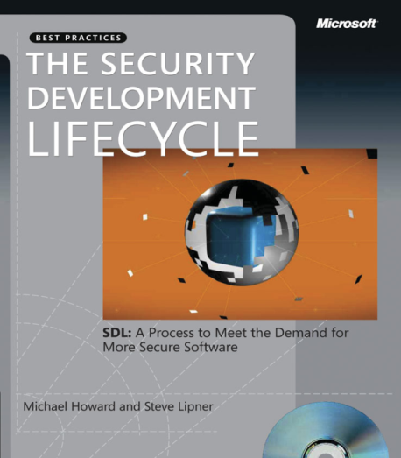


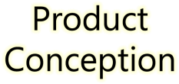
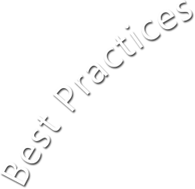














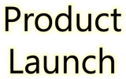







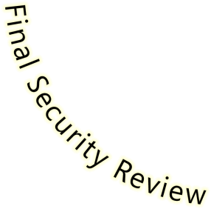


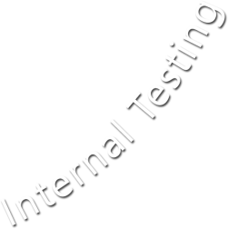





Microsoft Security Development Lifecycle (SDL)
SDL Book:
http://www.microsoft.com/mspress/books/8753.aspx
Official SDL Web Site: http://www.microsoft.com/sdl

Slide 24


Microsoft Writing Secure Code Book Series
Writing Secure Code,
2nd Edition:
http://www.microsoft.com/mspress/books/5957.aspx
Writing Secure Code for Windows Vista:
http://www.microsoft.com/mspress/books/10723.aspx

Slide 25
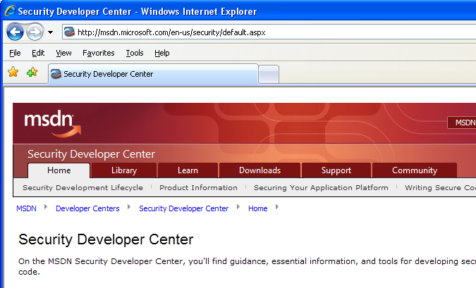

Microsoft Developer Network (MSDN) Security Developer Center
Official Web site: http://msdn.microsoft.com/security

Slide 26
Secure Development Blogs
The Microsoft Security Development Lifecycle (SDL) Blog: http://blogs.msdn.com/sdl
Michael Howard’s Blog: http://blogs.msdn.com/michael_howard

Slide 27
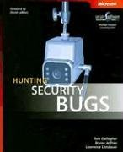
Microsoft Hunting Security Bugs
Hunting Security Bugs:
http://www.microsoft.com/mspress/books/8485.aspx

